Slide 1
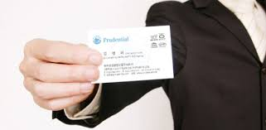
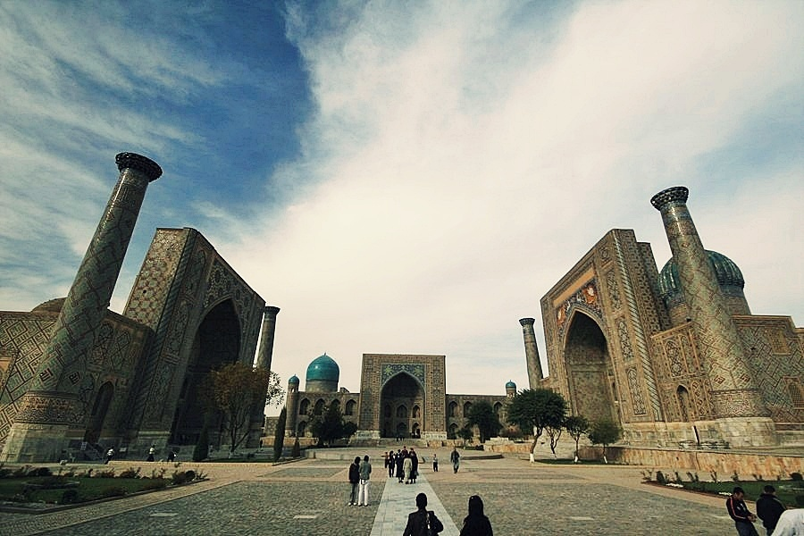


Making Mobile Name Card
Android study

Slide 2
Lecture
Time
Coding
Time

Slide 3
Java file & xml file

Slide 4


Functioning
One screen==one Activity
Activity
Layout
= Java file + xml file
Android
application
Designing application
make button, list, letter…
Like css and html of web

Slide 5
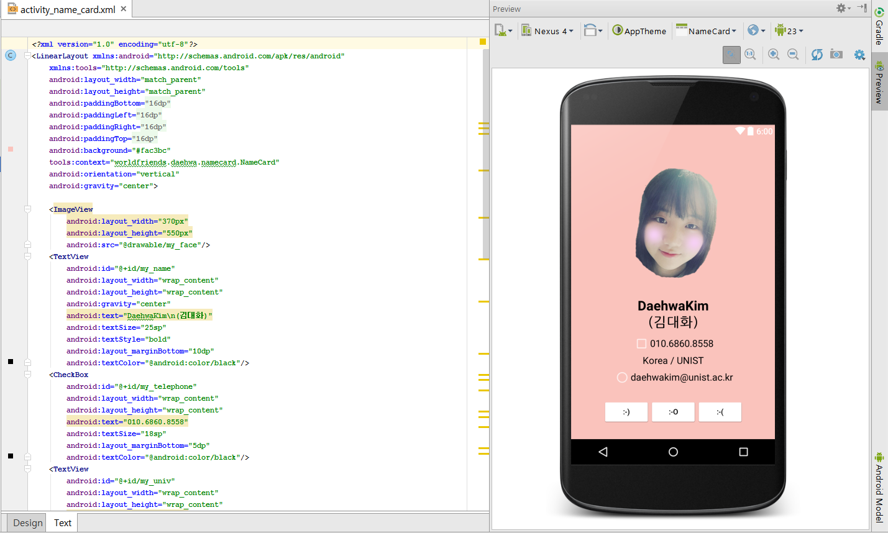
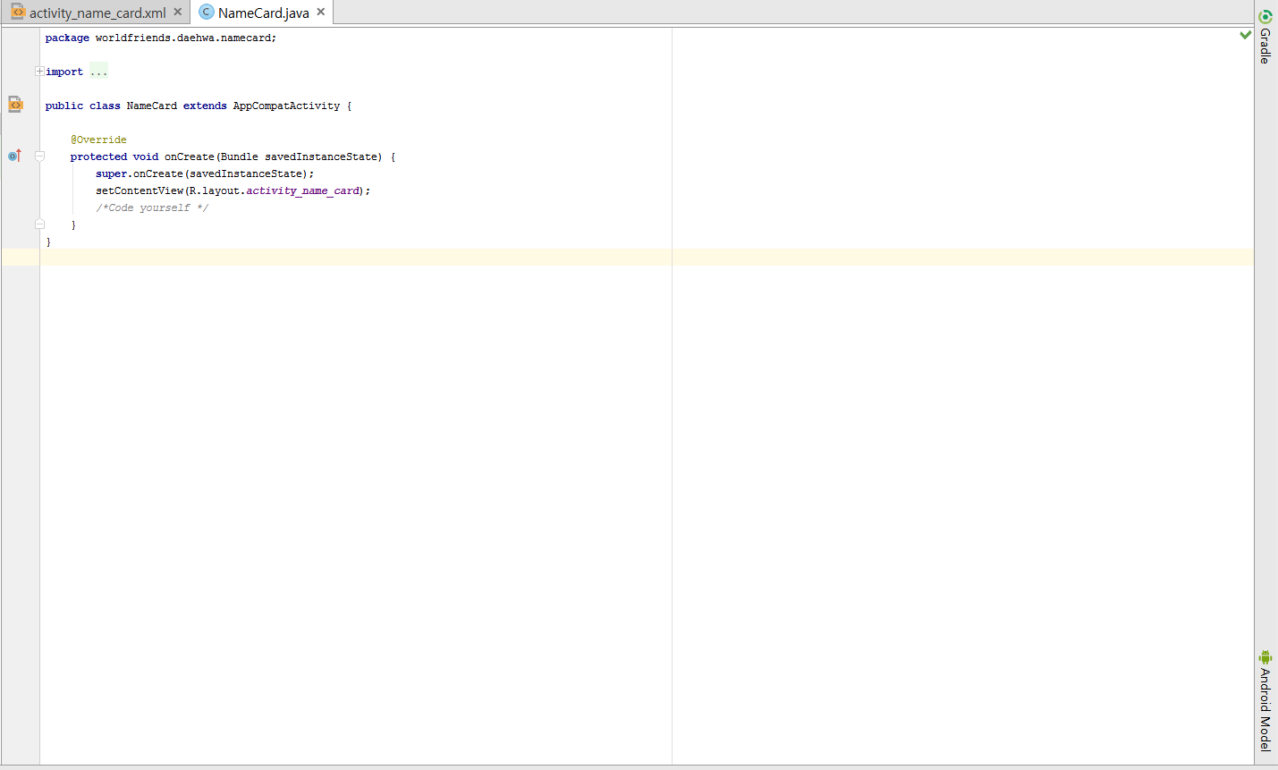
Java file(Activity)
xml file(layout)

Slide 6
About Android Studio

Slide 7

Java
JDK (Java Development Kit)
android Studio
SDK (Software Development Kit)
Notes:
Download Java: https://java.com/en/download/
Download JDK: http://www.oracle.com/technetwork/java/javase/downloads/jdk8-downloads-2133151.html
Download android Studio: https://developer.android.com/studio/index.html
SDK is downloaded when you install android studio if you check a box “download SDK”

Slide 8
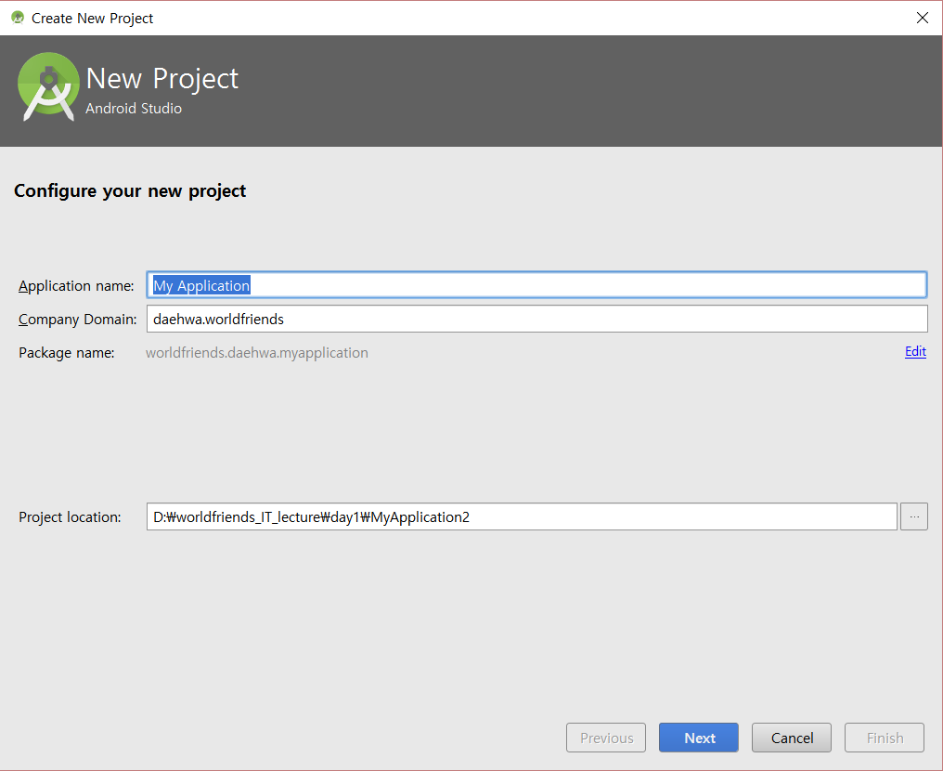
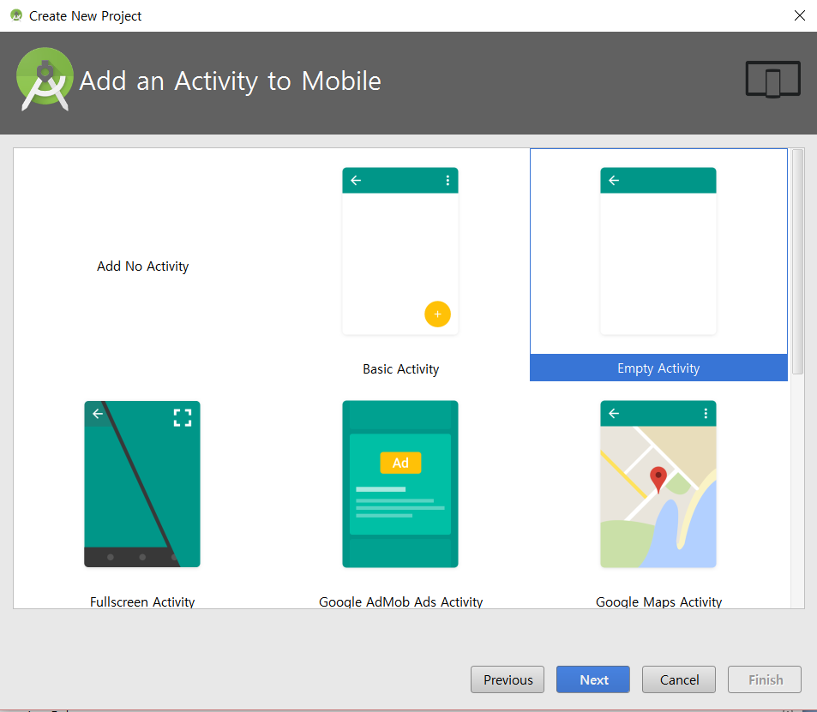
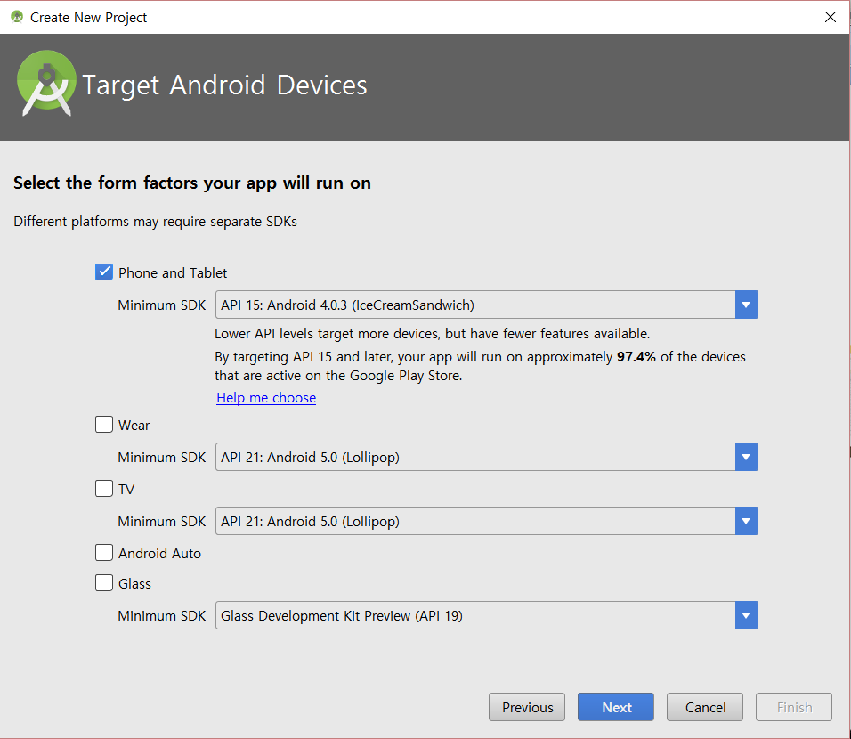
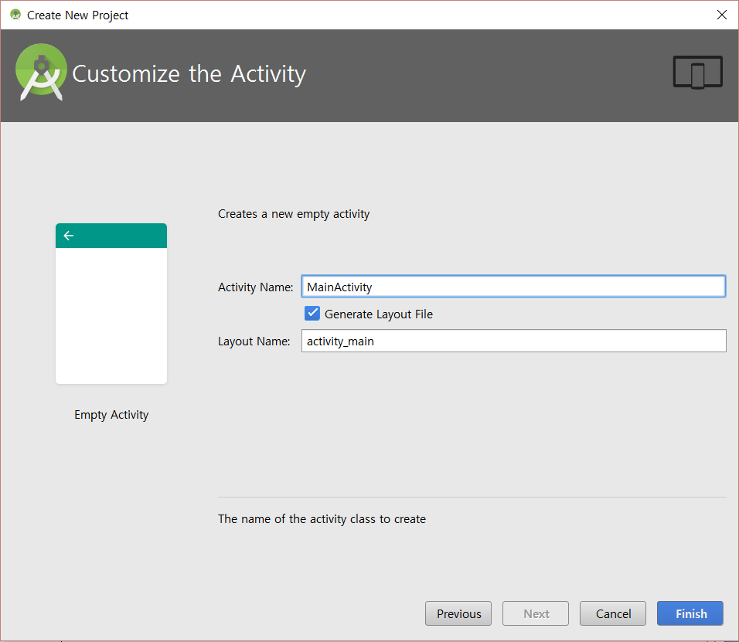
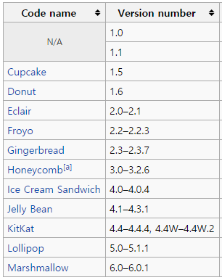

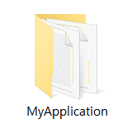
My professor said…
“Code is not just yours, any longer.
It has its real meaning when we share it.”

Slide 9
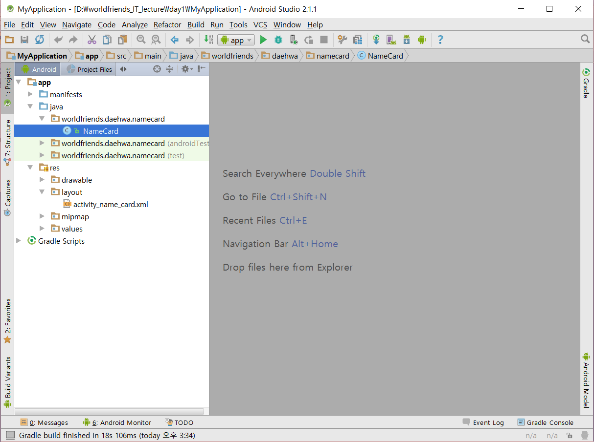
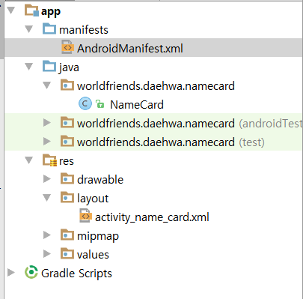

Slide 10
Designing (xml)

Slide 11
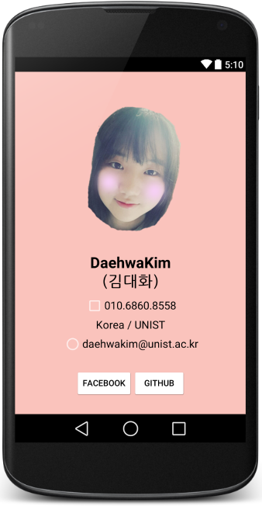
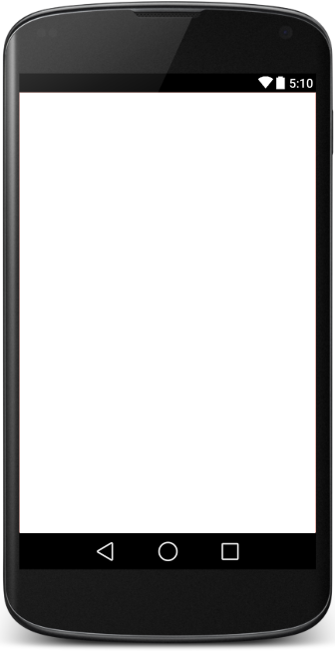
Goal
Anything
You want

Slide 12
Structure
<NameOfItem
property1
property2
...>
/*Other items*/
</NameOfItem>

Slide 13
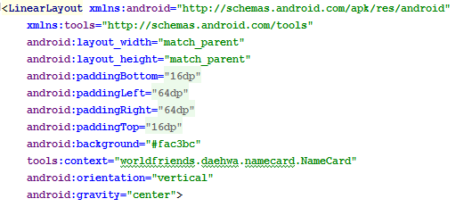
LinearLayout

Slide 14
LinearLayout vs RelativeLayout vs FrameLayout
AbsoluteLayout : Deprecated

Slide 15
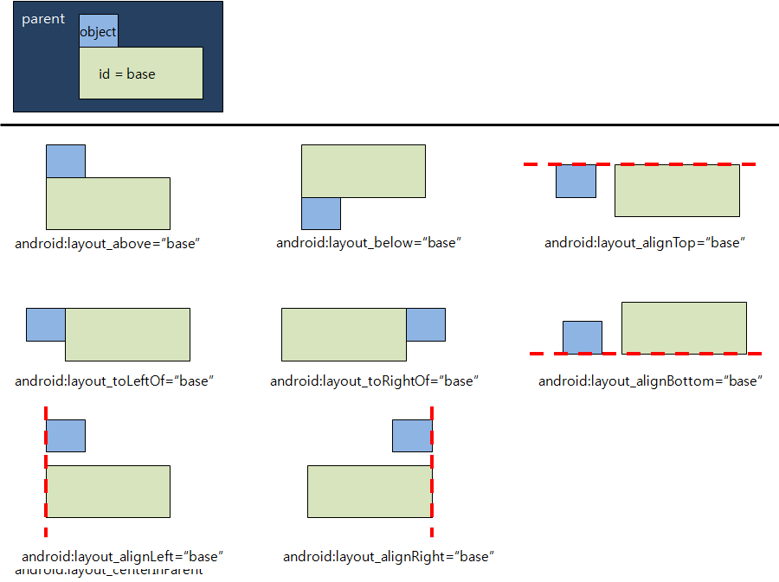
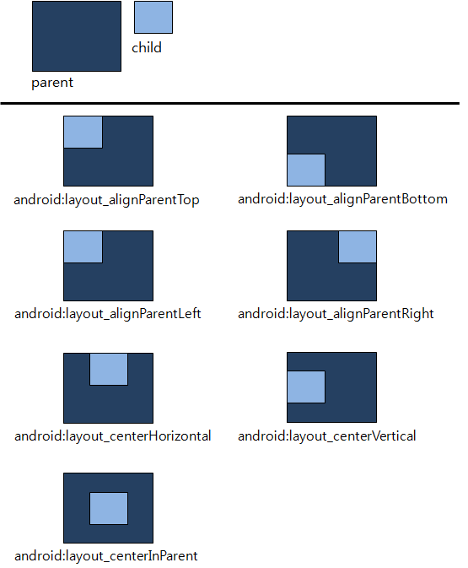
LinearLayout vs RelativeLayout vs FrameLayout

Slide 16

ImageView

Slide 17
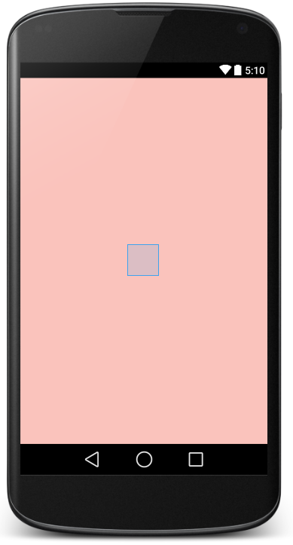
Resolution and dp
800 boxes of 1 pixel
1280*800
1280 boxes of 1 pixel

Slide 18
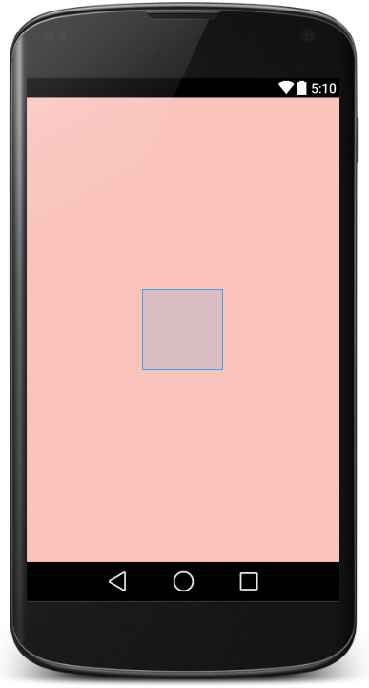
Resolution and dp
px(pixel)
dp(density-pixels)
dip(density-independent-pixels)
sp(scale-independent-pixels)

Slide 19
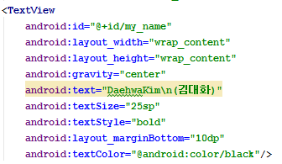
TextView

Slide 20
margin and padding
item
padding
margin

Slide 21
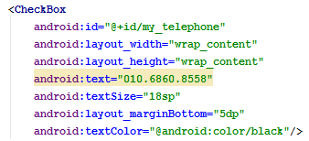
CheckBox

Slide 22
Color
1. #FFFFFF
2. @android:color/white
3. RGB(256,256,256)

Slide 23
Color
00~FF == 0~256
1. #000000
2. @android:color/black
3. RGB(0,0,0)
0~256

Slide 24
Color
#00000000
#AB000000
#FF000000

Slide 25
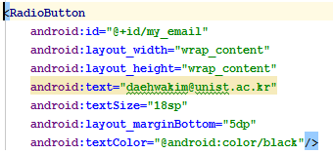
RadioButtom

Slide 26
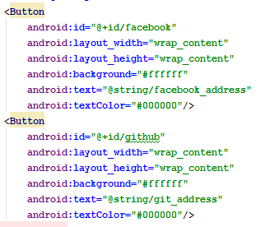
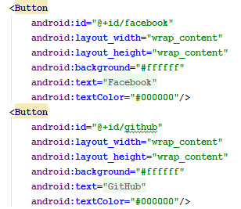
Button

Slide 27
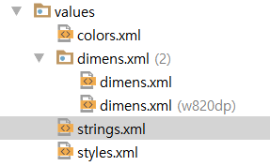
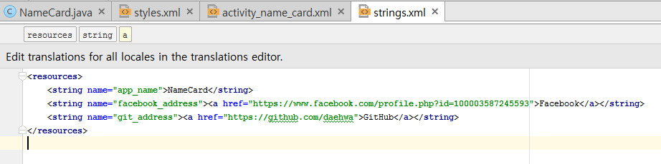
String.xml

Slide 28

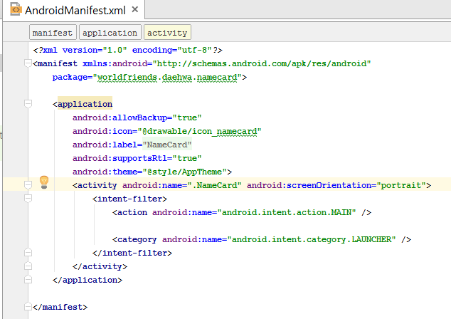
Manifest.xml
: Control Activities

Slide 29
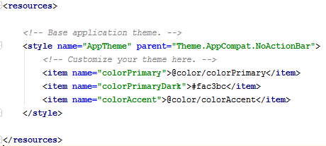
Style.xml

Slide 30
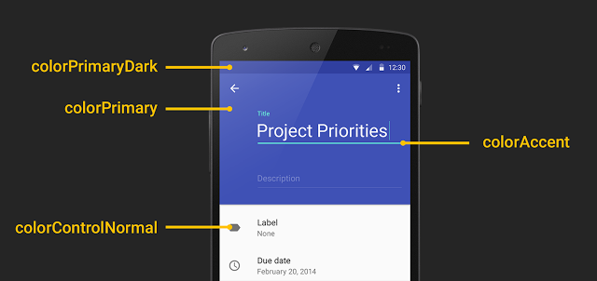
Style.xml

Slide 31
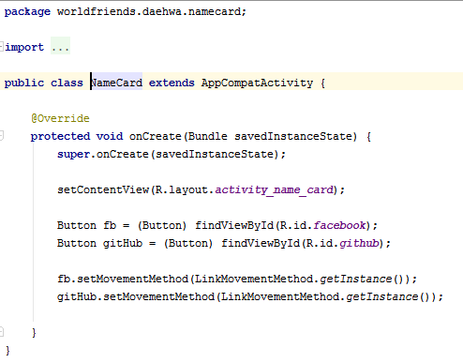
Little about Java

Slide 32

Download skeleton
https://github.com/daehwa/world-friends-Uzbekistan-android/

